Slide 1

Investigating the Causes of Player Frustration in Modern Games
A Large-Scale Review Analysis
Jiacheng Xia — NYU Abu Dhabi — Computer Science Capstone
Capstone Mentor: Mohamad Kassab
Secondary Grader: Mai Oudah

Slide 2




Why Study Player Frustration?
Business Impact
Emotional Driver
Research Gap
Directly affects player retention, enjoyment metrics, and ultimately game sales and revenue
One of the strongest emotional responses in gaming experiences, influencing behavior and reviews
Understudied as a software engineering problem despite clear connections to system architecture
Millions of player reviews represent an untapped data source for systematic analysis of frustration patterns

Slide 3

Research Questions
1
2
What causes frustration in modern games?
Can we categorize different types of frustration?
Identifying the primary technical, design, and psychological triggers that lead to negative player experiences
Creating a taxonomy of frustration patterns to enable more targeted solutions
3
4
Do certain frustrations map to specific game features or NFRs?
Can modeling frustration support better game development?
Connecting emotional responses to non-functional requirements and system architecture
Translating findings into actionable insights for developers and studios

Slide 4

Psychological Foundations of Frustration
Goal Obstruction
Classical frustration theory (Dollard & Berkowitz): Frustration occurs when planned actions are blocked or interrupted
Self-Determination Theory
Frustration emerges when psychological needs are unmet: autonomy, competence, and relatedness
Expectancy Violation
Modern frustration amplified by hype cycles and disappointment when expectations aren't met
These psychological frameworks guide our analysis of player feedback and review sentiment

Slide 5



Game Selection Criteria: Core Frustration Mechanisms
High Difficulty
Games with demanding skill requirements that create pressure on player competence (e.g., Souls-likes, competitive shooters)
Technical Interruptions
Games with documented performance issues, bugs, or server problems that disrupt play sessions
Punishing Design
Games with severe penalties for failure, progress loss, or restrictive mechanics that limit player freedom
Toxic Multiplayer
Games with documented community issues, harassment problems, or team-dependent success factors

Slide 6

Additional Selection Filters
Large Player Base
Games with substantial active populations expose subtle issues that might not appear in smaller communities
High Expectations
Games with significant pre-release marketing or developer reputation that creates elevated player expectations
Large Review Volume
Sufficient data to reach thematic saturation and identify consistent patterns
High Negative-Review Ratio
Games experiencing significant backlash provide natural experiments in frustration dynamics

Slide 7

Data Sources & Scale
Steam
Structured user reviews collected through official API with metadata
Reddit
Community discussions accessed via PRAW with heuristic filtering for relevant content
Metacritic
Critical and user reviews extracted using Selenium automation to bypass infinite scroll limitations
≈ 2,000,000 reviews collected
Required efficient streaming and storage pipelines to process at scale
Official Forums
Long-form player feedback and patch note discussions from game-specific communities

Slide 8
Preprocessing Pipeline
Time Window Selection
1
Applied consistent 2-year window across all data sources to ensure temporal alignment
2
Language Filtering
Used ASCII heuristics, dedicated language detection models, and API filters to isolate English content
Deduplication
3
Removed duplicate entries and standardized schema across platforms for unified analysis
4
Hybrid Sentiment Analysis
Combined DistilBERT, VADER, and custom rules to classify review sentiment with high accuracy
Negative/Mixed Filtering
5
Focused analysis on negative and mixed-sentiment reviews where frustration signals are strongest

Slide 9

Topic Modeling Strategy: LDA Limitations
Initial Approach: Latent Dirichlet Allocation (LDA)
Tested with varied configurations:
Multiple topic count settings (k=2 to k=50)
Different vocabulary pruning thresholds
Various Dirichlet prior configurations
Unigram and bigram feature extraction
Evaluation Metrics
c_v coherence
c_npmi coherence
Perplexity measures
Limitation
LDA consistently collapsed themes into overly broad categories (e.g., "game bad" vs. "community bad"), providing insufficient resolution for meaningful insights

Slide 10
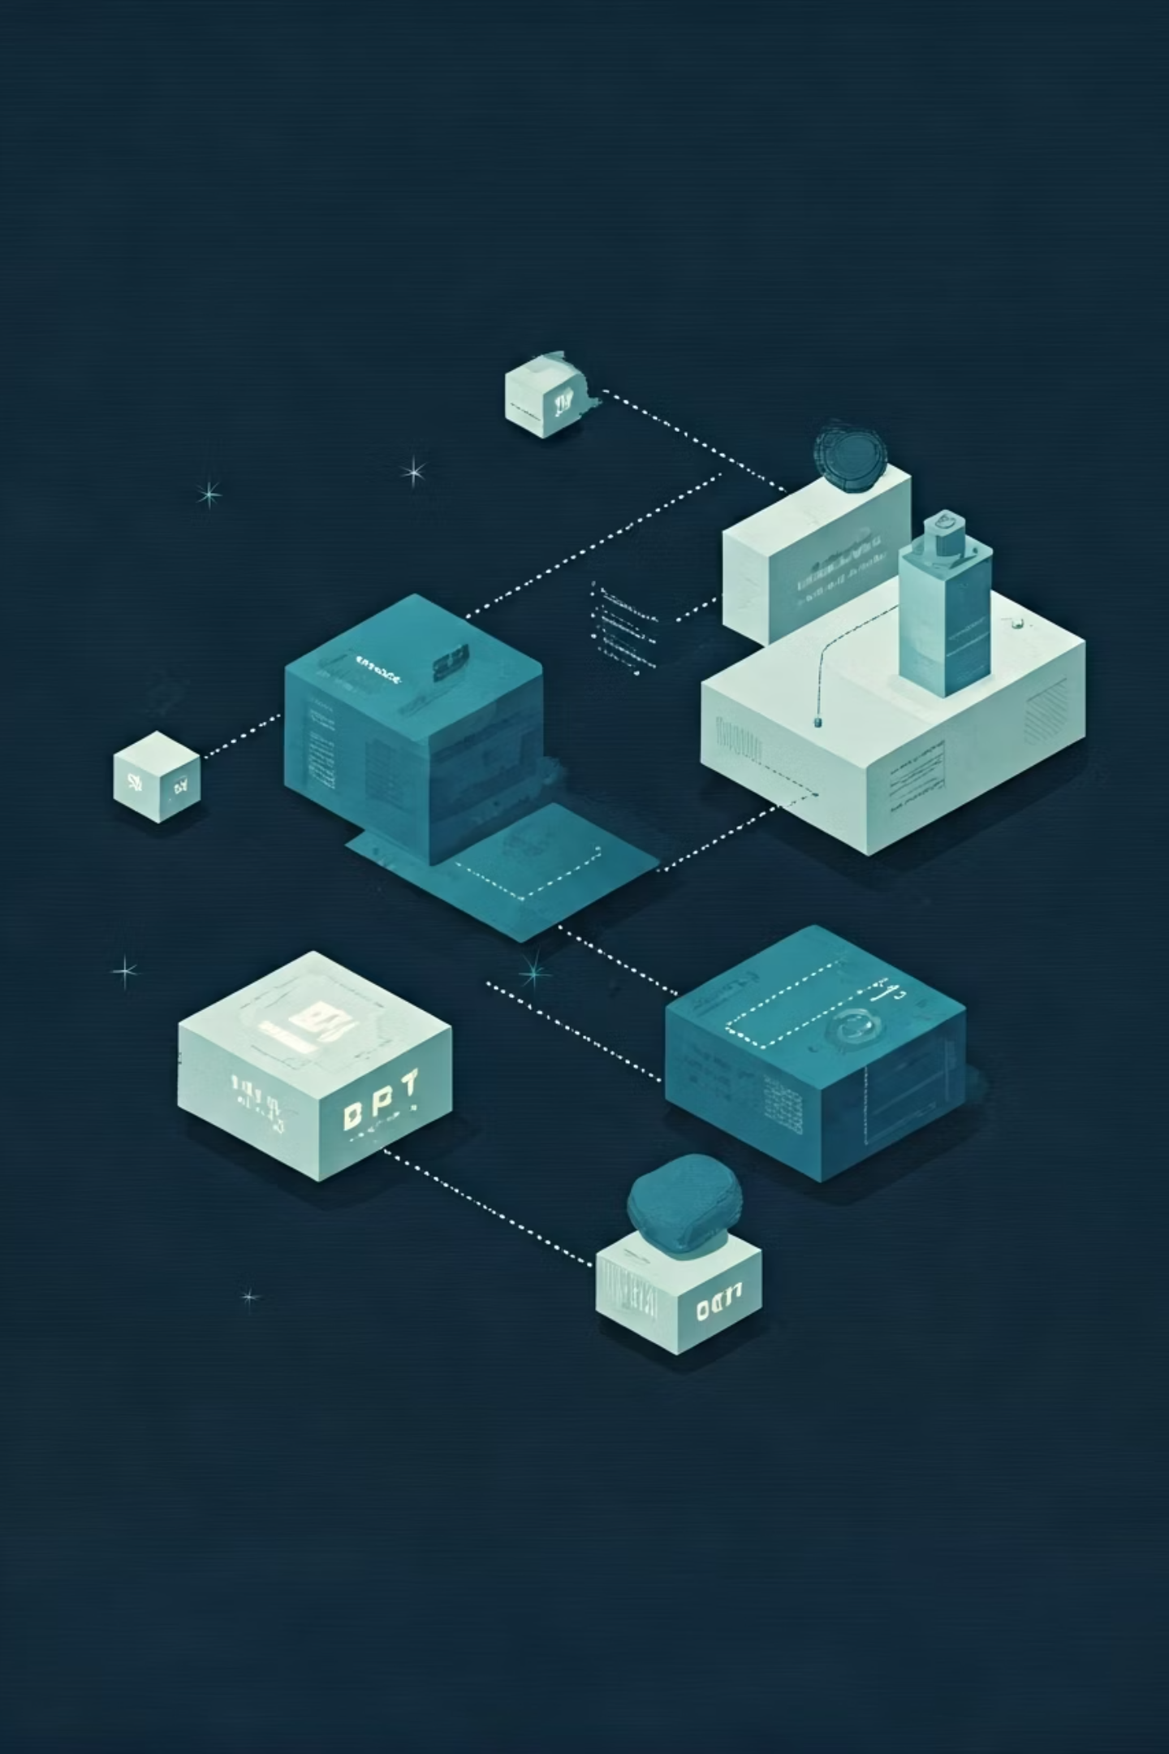


BERTopic & Custom Stopwords
Transformer Embeddings
Replaced bag-of-words with contextual embeddings to capture semantic relationships between reviews
HDBSCAN Clustering
Implemented density-based clustering that automatically determines optimal topic count based on data structure
Custom Stopword Refinement
Iteratively built specialized stopword list removing:
Gaming slang and jargon
Profanity and emotionally charged filler
Game-generic terms ("game," "play," "use")
Platform-specific artifacts
Community memes and inside jokes
Final Output
Produced 30 distinct, interpretable frustration topics with clear separation and coherence

Slide 11




Mapping Topics to Non-Functional Requirements
Usability
Accessibility
Confusing design elements, balance issues, communication problems, unintuitive interfaces
Account linking barriers, OS restrictions, time requirements, physical limitations
Fairness
Performance
Matchmaking imbalance, smurf accounts, cheating, pay-to-win mechanics
Crashes, lag, framerate issues, load times, server stability problems
A key contribution: Frustration naturally maps to established software engineering categories used in architecture evaluation

Slide 12



Usability Failures
Balance Changes (Topic 0)
"They keep nerfing my favorite character every patch. What's the point of learning the game when everything changes constantly?"
Toxic Chat (Topic 13)
"The community is so toxic that I can't even use voice chat anymore. Getting screamed at by teammates ruins the entire experience."
Grind-Heavy Progression (Topic 23)
"It takes 40+ hours of mindless grinding just to unlock basic features. The progression system feels designed to waste our time."
Usability failures directly reduce players' ability to interact with game systems effectively and consistently

Slide 13

Accessibility Failures
Regional Account Restrictions
OS-Level Compatibility Issues
Topic 1: Players locked out of Helldivers 2 due to mandatory PSN account linking requirements, particularly affecting regions where PlayStation Network doesn't operate
Topic 12: Linux players completely excluded by mandatory Secure Boot anti-cheat requirements that only function on specific operating systems
Time-Gated Progression Systems
Topic 19: Battle pass mechanics forcing daily login requirements that exclude players with limited time availability, creating anxiety about missing limited-time rewards
These issues don't just frustrate — they physically block access to content, creating strong emotional responses

Slide 14
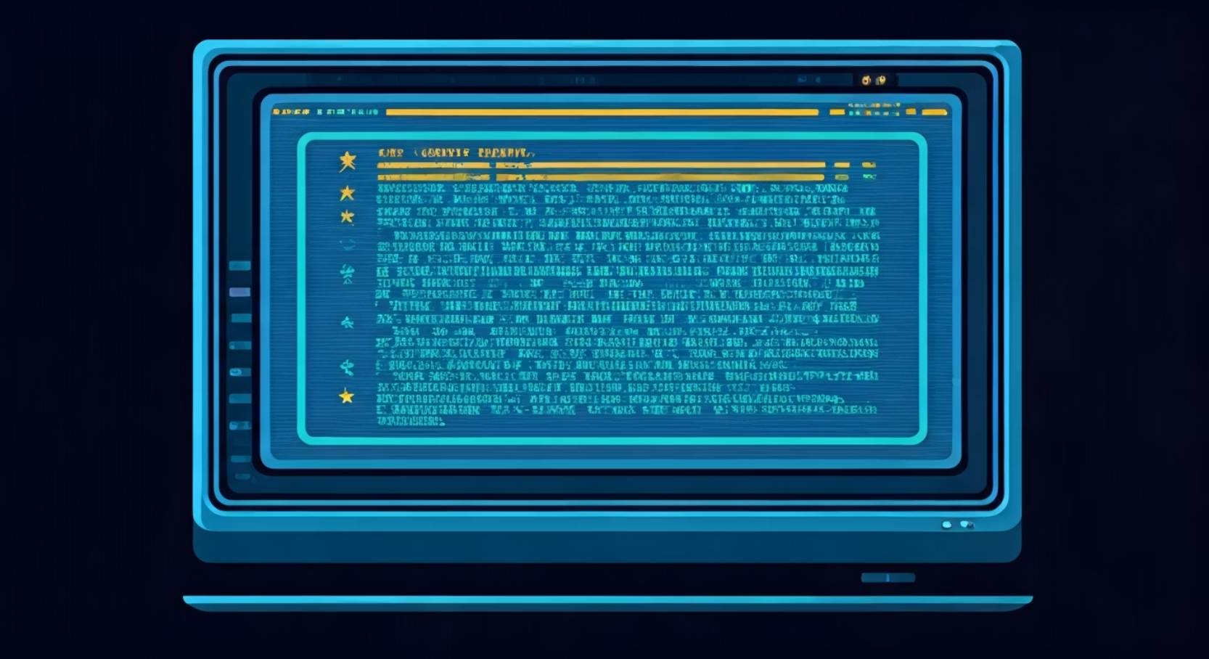
Performance & Availability Failures
—
—
Server Issues
FPS Problems
Players reporting server crashes, disconnects, and login queue problems
Complaints about unplayable framerates, stuttering, and optimization failures
—
Performance issues trigger stronger emotional language than most gameplay-related complaints
Network Issues
Reports of lag spikes, desync, and connection instability affecting gameplay
From an architectural perspective, these correspond directly to availability and performance non-functional requirements

Slide 15

Fairness Failures
Unfair Matchmaking (Topic 3)
Smurfing (Topic 28)
Experienced players creating new accounts to bypass skill-based matchmaking, creating extremely unbalanced matches for beginners
Players report significant skill mismatches and develop suspicions of "rigged" systems designed to manipulate engagement
Cheating (Topic 5)
Frustration with ineffective or nonexistent anti-cheat systems that fail to detect or punish obvious rule violations
Players exhibit the strongest emotional reactions to perceived unfairness, with these issues undermining trust in the entire game ecosystem

Slide 16

What Didn't Emerge: Difficulty
Surprising Absence:
Despite common assumptions, no significant topic emerged complaining about games being "too hard"
Possible Explanations:
Self-selection: Players who dislike challenge avoid difficult games entirely
Priority hierarchy: Difficulty frustration is overshadowed by more concrete issues like crashes or fairness
Cultural shift: Modern gaming communities increasingly expect and value challenge
Design evolution: Better tutorials, difficulty options, and onboarding have reduced difficulty-related frustration
This finding challenges the stereotype that difficulty is a primary source of player frustration

Slide 17

Key Insights
Systemic Frustration
Technical Dominance
Modern frustration stems less from individual mechanics and more from complex systems—account management, anti-cheat implementation, progression structures, and matchmaking algorithms
Technical failures produce the strongest emotional responses, particularly those that block goals entirely (crashes, connection issues) or waste player time
Fairness > Difficulty
Expectation Management
Players accept challenge but reject perceived unfairness—especially in competitive environments where skill assessment is central to the experience
Pre-release marketing, developer promises, and review embargoes significantly impact how players emotionally respond to issues at launch

Slide 18


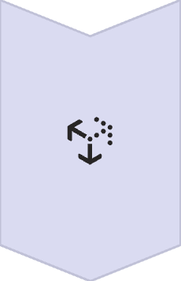


Implications for Developers
Early Detection Systems
Implement review mining to detect emerging frustration themes before they become widespread
NFR-Driven Evaluation
Evaluate games not just on design but on non-functional requirements—especially fairness, accessibility, and performance
Fairness as Core Requirement
Treat fair matchmaking, anti-cheat, and progression as mission-critical systems deserving dedicated resources
Continuous Sentiment Monitoring
Deploy real-time sentiment dashboards to help teams respond to issues before they escalate into community crises

Slide 19
Limitations & Future Work
Limitations
Future Work
Review bias toward vocal users may not represent silent majority
Predictive modeling to forecast frustration spikes before they occur
English-only analysis excludes important international communities
Live developer dashboards for real-time frustration monitoring
Sarcasm and irony detection remains challenging for sentiment models
Automated NFR extraction pipelines integrated into development workflows
Model sensitivity to preprocessing and parameter choices affects results
Cross-cultural analysis of frustration patterns in different markets

Slide 20
Conclusion
Frustration is a complex emotional response shaped by psychological needs, expectations, and software quality attributes
Key Contributions:
Comprehensive taxonomy of player frustration sources in modern games
Novel mapping between emotional responses and software engineering NFRs
Scalable methodology for analyzing large-scale player feedback
Evidence-based recommendations for frustration-aware game development
Thank You!
Questions?

